Slide 1
Take Me Home, Country Code: an Artificial Intelligence Designed for the Analysis and Creation of Country Music Lyrics
By-
Emmanuel Olaleye
Andrew Mersinger
Aishwarya Panchumarty
William Boodon

Slide 2
Motivation
Inspired from previous project “Is it Gangsta?” AI designed to identify gangster rap and the AI created to write poetry
Used country music because it is trope-heavy. Usually contains the same themes such as trucks, roads, farms, and rural lifestyle which we thought would be perfect for our project

Slide 3
Libraries and Algorithms
BeautifulSoup - Used as a web crawler and as a data parser
N grams - Used trigrams specifically to calculate the probability of a word for use in our generative model

Slide 4
Data Sources
Initially used songlyrics.com, but had to change since many of the links were broken and the sample size was small
Later on, we found a database made by professor Dave Tompkins which provided over 1000 country songs for us to use

Slide 5
Project Setup
Extracted data from songlyrics.com using Python’s library BeautifulSoup
Originally had one text file per song, realized this was inefficient
Changed web parser and had it combine all of the songs & put them into one text file

Slide 6
Preliminary Results
Initially planned to make our project based off of another project called “Dope Learning”, but we found other projects which better suited our needs
We found two projects on Github:
Lyrics-generation-using-Ngrams by Shubham Jain
Rap-Lyrics-Generator by Keerthana Sriranga

Slide 7
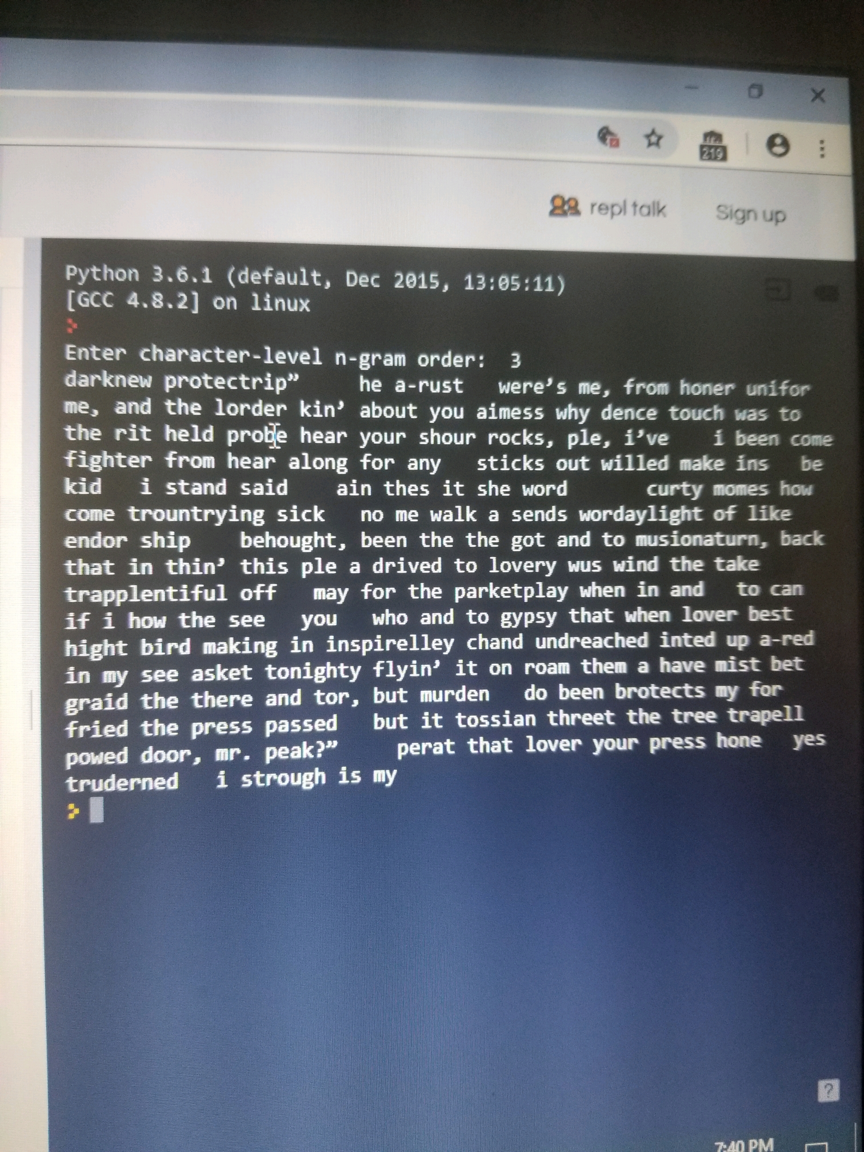
Output from the Lyrics-generation-using-Ngrams Project
Didn’t make any sense
Words were generated randomly
Trained using character by character

Slide 9
Output from the Rap-Lyrics-Generator Project
An improvement over the last project, but still insufficient
However uses Markov bigram model
Small sample size with bigram did not produce good results

Slide 10
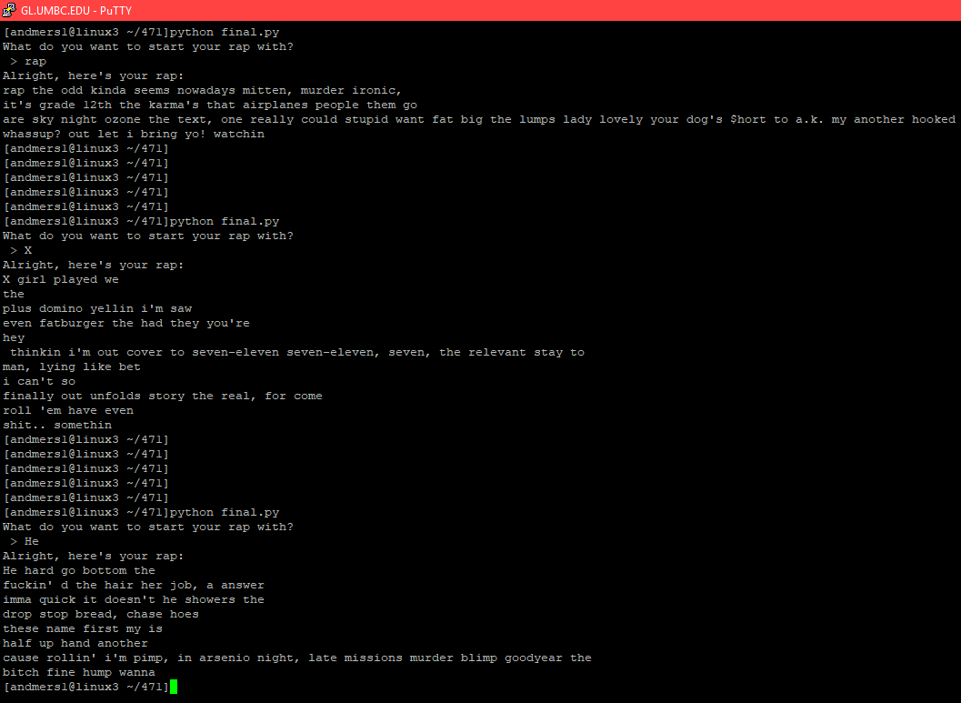

Slide 11
Changes that we made
Extracted songs from professor Dave Tompkins’ database instead
Formatted the file:
Removed all punctuation marks except the apostrophe
Converted all words to lowercase
Removed the structural features such as chorus and verse lines

Slide 12
Programming
Settled on a trigram model, large enough value of N to produce sensible output but small enough as to not overfit
Program takes user input, allows them to make the determination between uni-, bi-, and trigram modes
Uni- and bigrams exist more for comparison to trigram than actual use

Slide 13
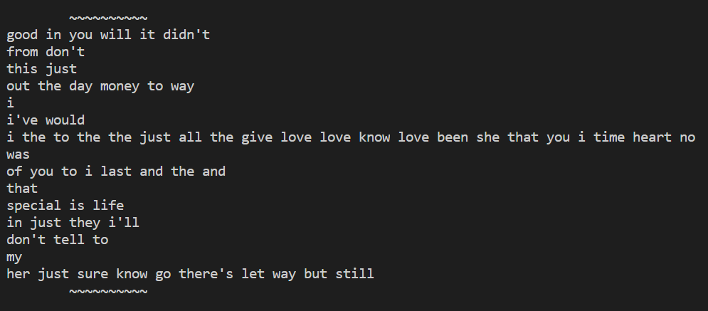
Unigram Example

Slide 14
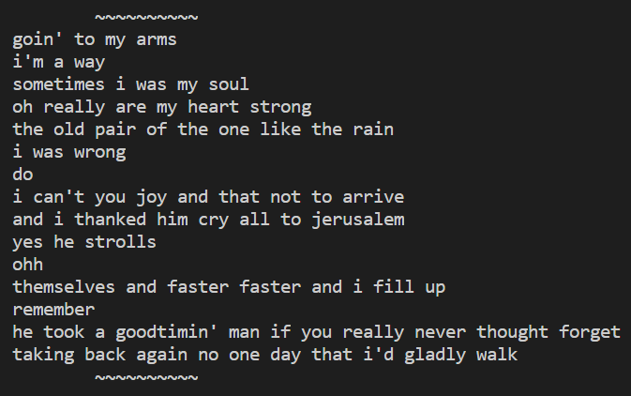
Bigram Example

Slide 15
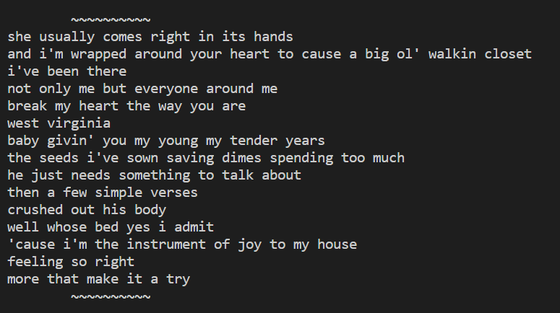
Trigram Example

Slide 16
Conclusion (pt. 1)
Clearly trigram model is superior, this is true in theory and validated by testing
4-gram or higher overfits and as the scale of the input corpus increases, memory and space complexity become an issue
Therefore, stick with trigram
Some of our favorite trigram results:

Slide 17
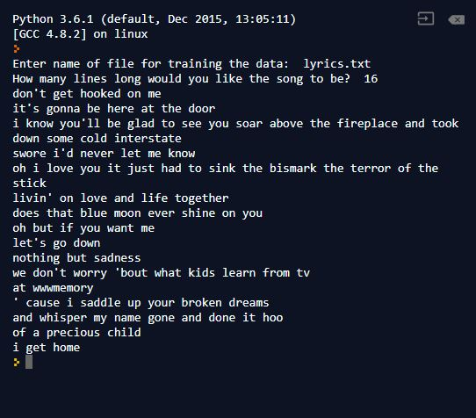
Results (Trigram)

Slide 18
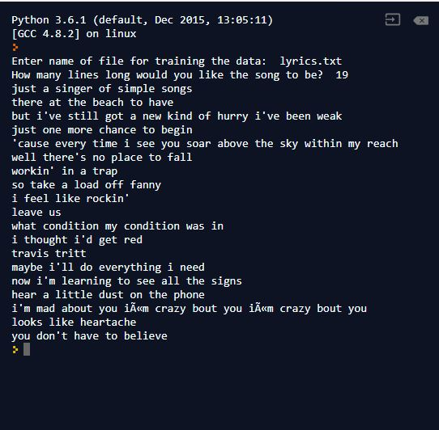
Results (Trigram)

Slide 19
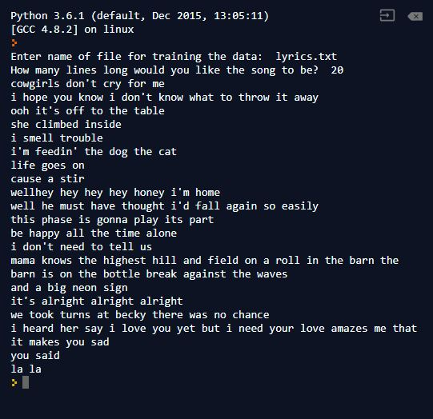
Results (Trigram)

Slide 20
Conclusion (continued)
Trigram absolutely sufficient, no need to advance to 4- and 5-gram models and incur their drawbacks
Could possible improve project by adding abstraction, potentially in a way that would allow it to more easily handle other genres
Do this by collecting metadata about the song, so the model can learn how to produce the structure as well

Slide 21
References
Links to projects we used for preliminary results:
https://github.com/Blaziking/Lyrics-generation-using-Ngrams/blob/master/ngram%20generator.py
https://github.com/keerthanasriranga/Rap-Lyrics-Generator/blob/master/RapLyrics.py
Link to Professor Dave Tompkins Music Database:
https://www.cs.ubc.ca/~davet/music/list/Best2.html

